Slide 1
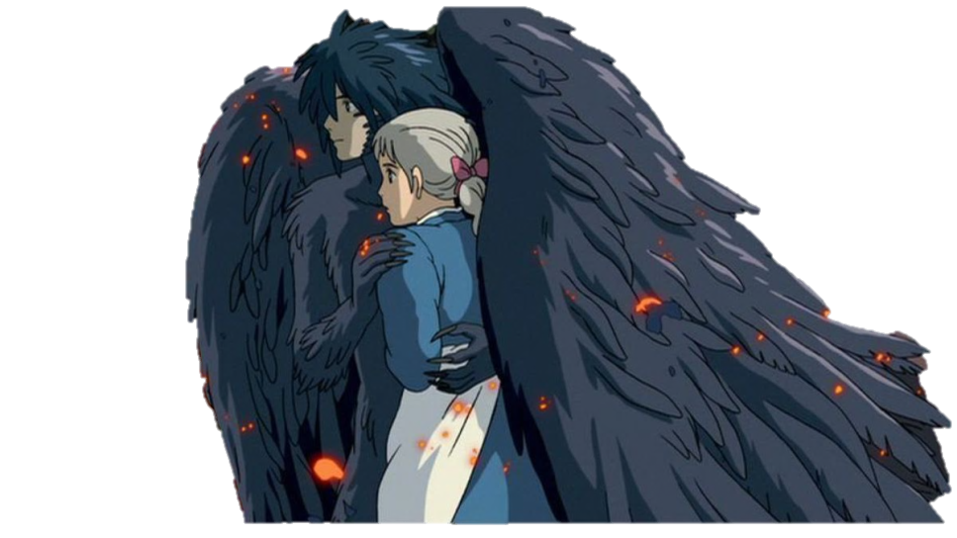
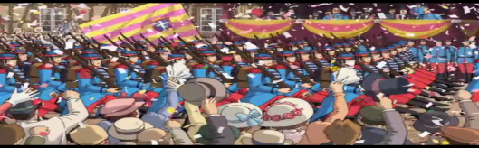
THE THEME OF ACCEPTANCE IN ‘HOWL’S MOVING CASTLE’
by Jen Smith and Aimee Gillett

Slide 2
Introduction
Militarism is defined as a strong military policy of a country and the support of a national spirit. The theme of acceptance is wide-spread throughout society and is contained within ‘Howl’s Moving Castle’, an anime film directed by Hayao Miyazaki, in order to construct and gain particular responses from viewers along with providing them with knowledge within scenes about the idea of acceptance itself. Acceptance is defined as the action of consenting to receive or undertake something offered; in our chosen mise-en-scene, the entire war is accepted by the people in the city and this is shown by them celebrating at the parade of which war soldiers, planes, horses and tanks enter the city. ‘Howl’s Moving Castle’ follows a young girl named Sophie who, after meeting and falling in love with a wizard named Howl, is cursed by the Witch of the Waste and transforms into an elderly woman; Sophie then spends her time trying to find a cure and staying alongside and helping Howl, along with his assistants, in this time of war. The film is set during an era that was known as the Age of Patriotism and was created during the Iraq War. Along with ‘My Hiroshima’; a contemporary classic picture book written by Junko Morimoto revolving around war, hope and survival; this text is classified as resistant and uses various technical codes as well as symbolism and language for certain purposes to do with its viewers.

Slide 3

Contextual Information
Howl’s Moving Castle was created by Hayao Miyazaki based on the novel by Diana Wynne Jones
It was first screened in Japan in 2004
The voice actors included; Emily Mortimer (Young Sophie), Jean Simmons (Old Sophie), Christian Bale (Howl), Lauren Bacall (Witch of the Waste), Billy Crystal (Calcifer) and Josh Hutcherson (Markl)
Movie is developed in the Anime style which is typically Japanese

Slide 4
Contextual Information: Historical
Howl’s Moving Castle was set during an era that was known as the Age of Patriotism (19th century Europe)
It was created during the Iraq War and also had a great deal of influence from the War on Terror (America post 9/11)
The town where Sophie lives is based on Alsace, a region of France which has historically been subject to a lot of military action as control of the area vied between Germany and France
Prior to the screening of Howl’s Moving Castle in Japan in 2004 many significant military events occurred that may have had an influence on the movie including;
The Gulf Crisis (1990)
The Gulf War (1991)
The 9/11 Terror Attacks (2001)
The Afghanistan War (2001)
The Iraq War (2003)

Slide 5
Contextual Information: Political
The film appears to be based on political components of the Japanese constitution and political ideals such as;
Article 9 which makes it illegal for Japan to use war as a means to settle international disputes
The constantly changing attitude of Japan towards war regarding acceptance of war or pacifism regarding war
The 1954 Self-Defense Forces Law that did not allow for the Japanese Defense Forces to leave the country to participate in outside warfare
The movie also portrays the constant political pressure that Japan felt from America who encouraged Japan to take part in international warfare

Slide 6
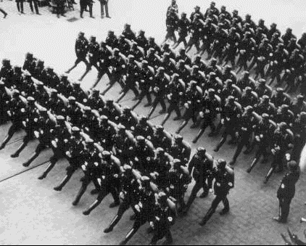
Contextual Information: Militarism
Militarism is defined as a strong military policy of a country and the support of a national spirit.
Militaristic and nationalistic attitudes were very common within Japan but not regarding international warfare. The Japanese were largely focused on their own interests as a world power.

Slide 7
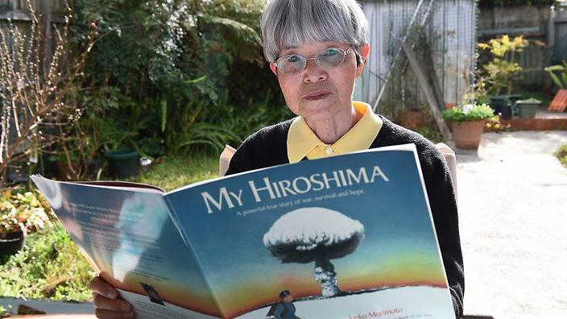

Intertextuality
My Hiroshima
a contemporary classic picture book, written by Junko
Morimoto, about war, hope and survival, along with what
happened to one young girl when an atomic bomb was dropped on her city. On 6 August, 1945, 13-year-old Junko Morimoto's life changed forever; this was the day that an atomic bomb was dropped on Hiroshima, the city where she lived.
Frankenstein
- a graphic novel written by author Mary Shelly that focuses on Victor
Frankenstein, a young scientist who creates a creature in a scientific
experiment. The first edition of the novel was published, anonymously,
in London in 1818, when Shelley was 20. Her name first appeared in
the second edition, published in France in 1823.

Slide 8
Synopsis
Howl’s Moving Castle follows a young girl (Sophie) who, after meeting and falling in love with a handsome wizard known as Howl, is cursed by the Witch of the Waste and transforms into an elderly woman. Ashamed by her age, Sophie travels away into the Waste in order to find the Witch and remove the curse. She doesn’t make it far before her old age effects her and she is forced to seek shelter in Howl’s moving castle, where she meets Calcifer the fire demon and Markl, Howl’s apprentice. She takes on the role of cleaning lady within the castle as she travels with her new companions. Not long after Sophie’s arrival Howl is summoned to the Palace to carry out royal duties and fight in the War. Howl initially refuses but Sophie agrees to attend on his behalf disguised as Howls mother in an attempt to persuade them that Howl would be of little service in war. Howl must use all his magical talents to battle the jealous hag, known as the Which of the Waste, and return Sophie to her former youth and beauty.

Slide 9
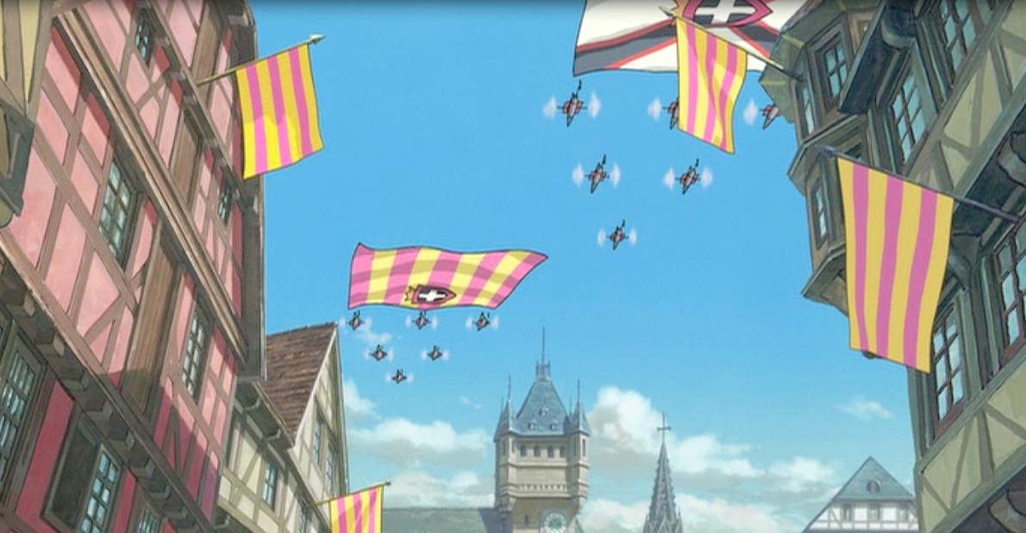
Symbolism
Some common symbols shown within the text include;
The flag representing excessive nationalism
Calcifer symbolising Howls heart
The moving castle being Howls life
Sophie’s curse being symbolic of the burden of old age as well as the role of the elderly in wartime
Canons on Sophie’s mothers hat and military parades expressing presence and acceptance of militarism in society
Markl is representative of Howl’s inner child

Slide 10

Mise-en-scene

Slide 11
Impact of Language and Structural Choices
The language and structural choices made by Miyazaki help to create a resistant reading with regards to the acceptance of militaristic views in society. When Sophie’s mother appears wearing a hat featuring canons between the flowers on it she states “It’s all the rage in Kinsgbury. Our customers will love it!” This quote suggests the casual acceptance that every day people have towards militarism and military practice, an idea that Miyazaki is strongly opposed to. The fact that military parades, such as the one shown in our mis-en-scene, are so widely celebrated in society is also an indicator that the creator has attempted to develop a resistant reading of the text. In most cultures, the presence of tanks and war planes or soldiers would cause panic and fear, yet the civilians displayed in the film view these things as something ordinary and even something worth celebration.

Slide 12
Change in Responses to Texts in Different Cultural Contexts and Over Time
Howl’s Moving Castle was produced in 2004 and views regarding militarism and war have changed very little since then. Many people in the general public have an objection to warfare yet governments continue to use militaristic policies in order to maintain and protect their countries. The movie can still be viewed as a criticism of war and militarism as it is still applicable to society. However, the responses to the text vary across cultural contexts. For example, those who view it in countries that have a strong military presence amongst civilians may understand the text to be one that endorses or supports a militaristic lifestyle whilst those in Western countries may see it as a criticism of this way of life.

Slide 13

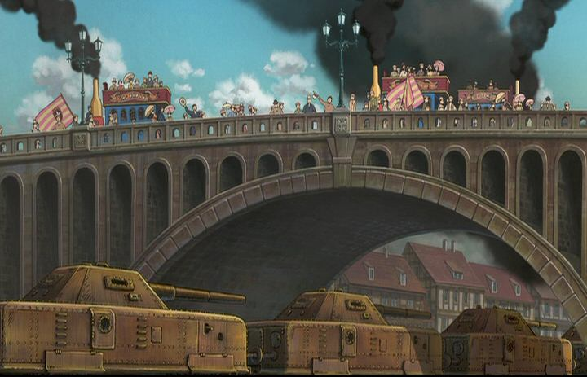
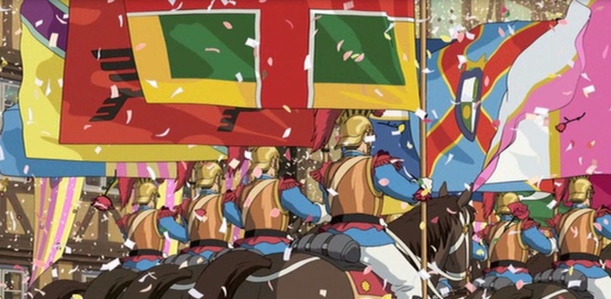
Reader Positioning
In regards to the idea of acceptance, viewers of ‘Howl’s Moving Castle’ are positioned in a way that allows them to recognise the scenes and times of which acceptance is given to characters, by other characters.
The producer and other relevant creators also provide historical and social context within the film in order for viewers to gain a better understanding of why the characters are accepting of the soldiers and tanks in the parade; in our selected mise-en-scene especially where the people are shown celebrating and cheering; along with accepting the fact that the war is taking place right upon their footsteps.

Slide 14
How Anime as a Genre Shapes an Audience Response
Anime is a style of animation originating in Japan containing stark colourful graphics depicting vibrant characters in action-filled plots. It is the Japanese word for animation.
Anime is used to shape an audience response towards acceptance in our mise-en-scene as it is an extremely popular genre throughout the globe and has a target audience of young children, all the way through to adults.
This genre is also primarily used to attract and grab the attention of viewers to promote the idea of acceptance through a more interesting and popular style of text. By viewers gaining a better understanding of what they want to watch, they also develop a certain response that is shaped by this genre purely because they are intrigued by and enjoy watching it.
If the same situation was presented in a documentary, for example, not as many people would bother to think about how the idea of acceptance is represented in the scene as documentaries are largely seen as less entertaining texts.

Slide 15
Conclusion
Howl’s Moving Castle created by Hayao Miyazaki is an anime movie that highlights and criticises the questionable acceptance of militarism and warfare within society. It uses various technical codes as well as symbolism and language to help create a resistant reading to the ideas and events that it represents.

Slide 16
Bibliography
https://www.merriam-webster.com/dictionary/anime
4/09/17
http://www.sparknotes.com/lit/frankenstein/summary.html
4/09/17
https://www.goodreads.com/book/show/116233.My_Hiroshima
4/09/17
https://en.wikipedia.org/wiki/Article_9_of_the_Japanese_Constitution
3/09/17
https://www.goodreads.com/author/show/67385.Junko_Morimoto
1/09/17

